Slide 1

Capstone Project
Prepared by – Akanksha Mishra
Grey Atom School of Data Science

Slide 2
About - MFCS
MFCS is a part of Mahindra Group – India’s leading conglomerate
Mahindra First Choice Services (MFCS) is a company of Mahindra Group and is India’s leading chain of multi-brand car workshops with over 335+ workshops present in 267+ towns & 24 states. It has serviced over 10,50,000 cars. The company aims to establish countrywide network of over 400 workshops by March 2018.
List of Services provided by MFCS:
Periodic maintenance services
Running repairs
Body repair
Warranty beyond warranty
Car care
Wheel care

Slide 3
Problem Statement
Geolocation Based Customer Analysis
  ​Identifying the ownership pattern of cars throughout the country.
    More than 99% of the customers are retail.
  Identify the type of order each state receives and present it as an interactive visualization.
Market Segmentation:
  Customer Lifetime value prediction - Based on Customer segments, predict the revenue that can be extracted from each segment over a life of the car -Regression/Time Series.

Slide 4
Data Set
5 different csv namely customer, invoice, jtd & plant.
Customer csv: 5,55,338 rows and 10 columns.
Invoice csv: 9,84,741 rows and 59 columns.
Jtd csv: 5619484 rows and 10 columns.
Plant csv: 483 rows and 14 columns.

Slide 5
Approach
Data Cleaning:
Checking for missing values.
Dropping columns having missing values greater 70%.
Filling missing values with mode.
Stripping leading zero in various columns.
Converting columns to string type for merging.

Slide 6
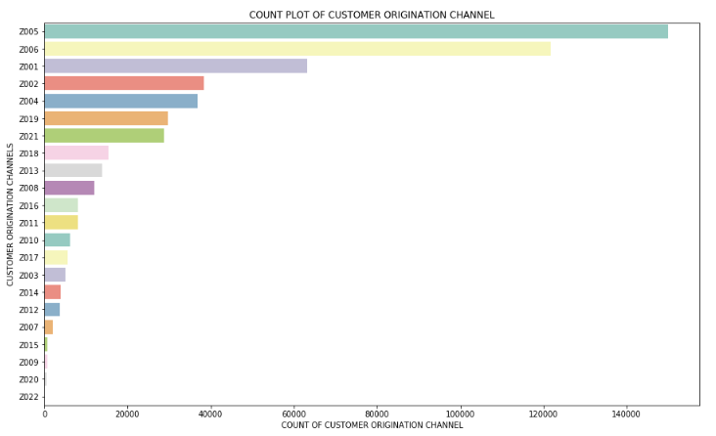
Customer Origination Channel
Z005 i.e Reference from customers tops the list
Z006 i.e Reference from employees
Z001 i.e Outdoor camping

Slide 7
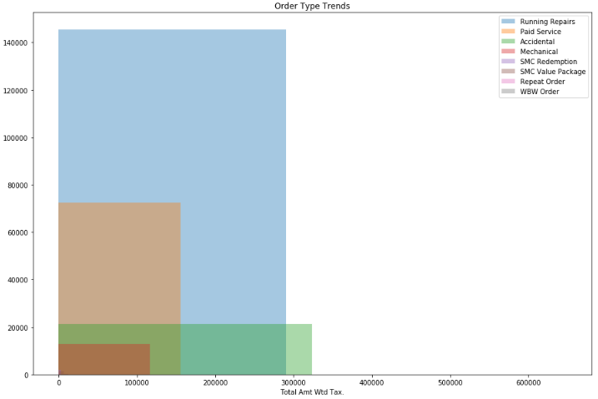
Order Type Revenue Trends
Frequency of Running services customers is highest.
Accidental service order generates highest revenue.

Slide 8
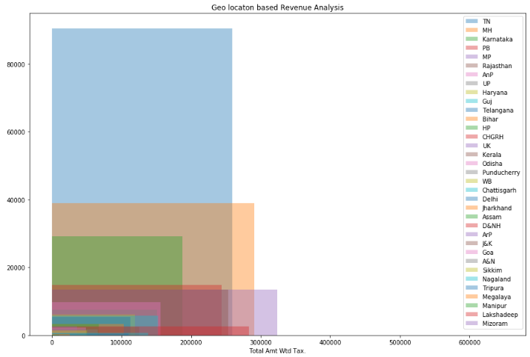
State wise revenue generation
TN has highest customer base followed by Maharashtra.
Top 3 revenue generating states are
Pondicherry
Maharashtra
TN

Slide 9
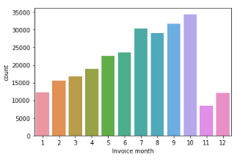
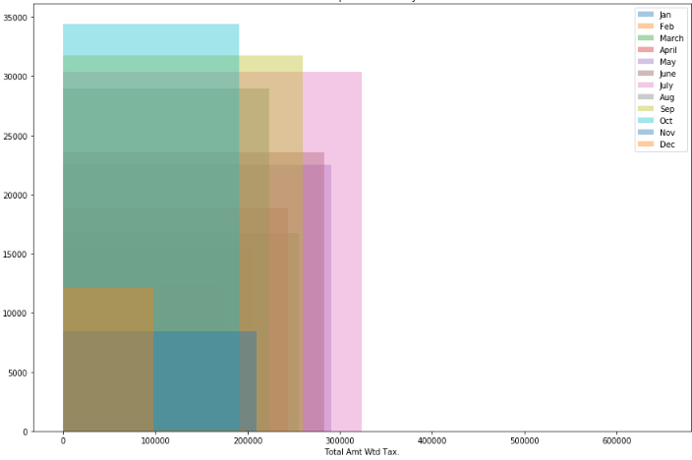
Month wise revenue trend
Observations: Car visits is highest in the month of October though revenue in July month is highest (due to monsoon related servicing)

Slide 10
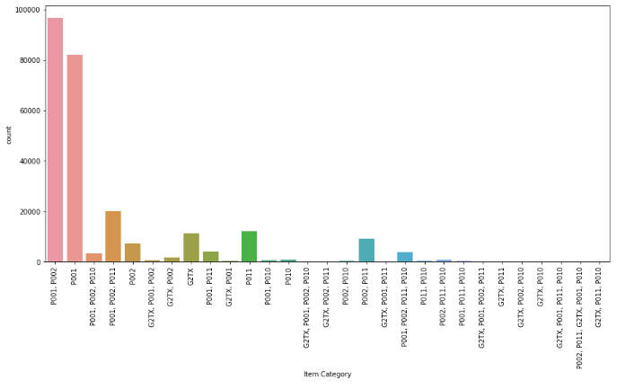
Popular items for Service orders
P001, P002 are the most popular items utilized for fulfilment of service orders.

Slide 11
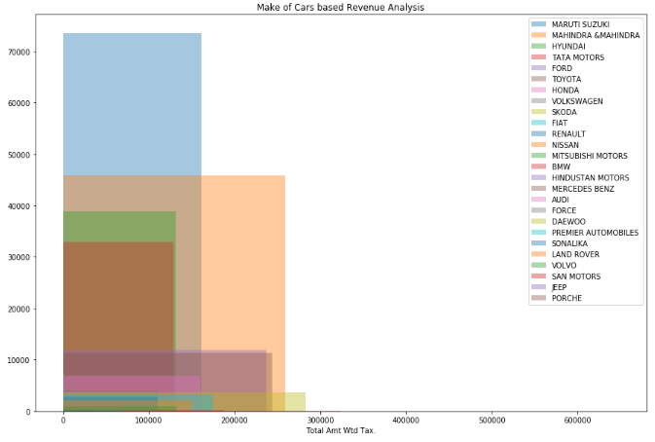
Car make wise revenue trend
Maruti Cars have highest frequency of visit
Skoda cars generates highest revenue

Slide 12
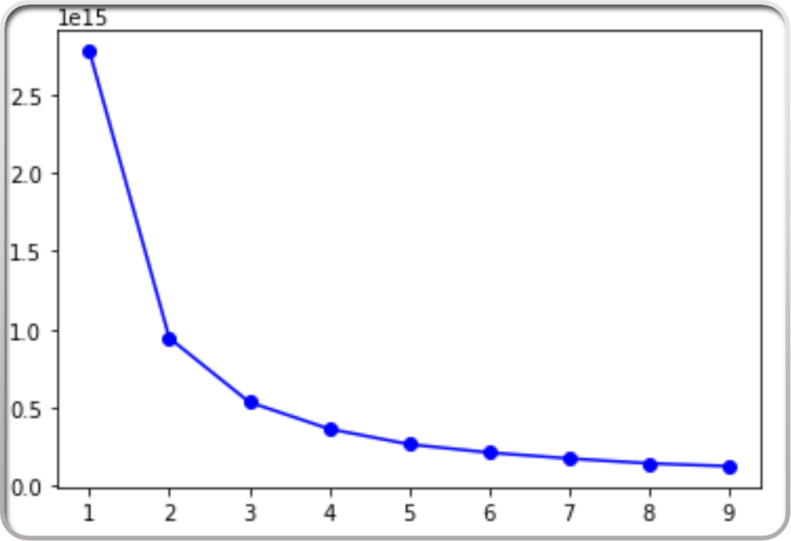
Elbow Method for clustering
K-Means clustering was used to cluster/segment the customers into groups.
The number of clusters for customer segmentation were decided using Elbow Method.
At k=5 there is a significant drop in the WCSS (within cluster sum of squared error).

Slide 13
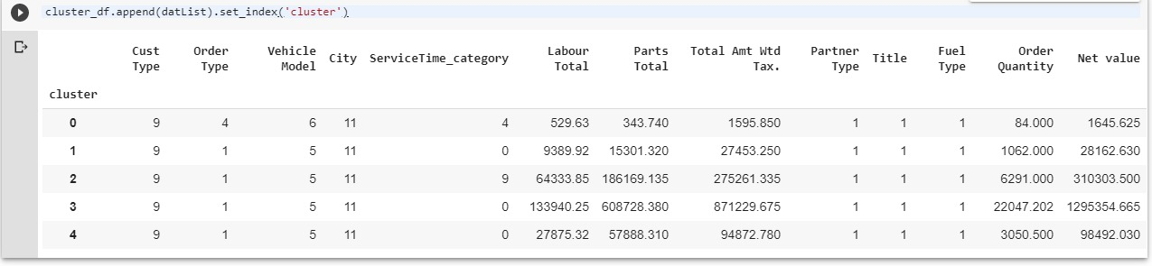
Cluster Identification
Each cluster can be identified with the unique properties given in the columns

Slide 14
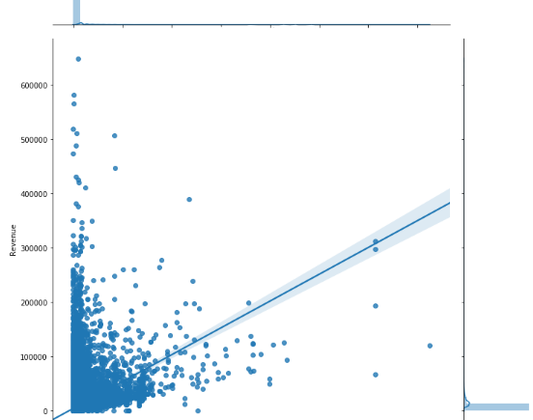
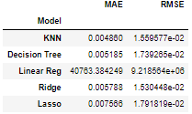
Market Segmentation
Predicted revenue generation capability for customers with same features.
Accuracy chart is as below:

